Slide 1
Image Segmentation
Spambase
Data Cleaning
Normalisasi
PCA
Dataset Rebalancing
5-Fold CV
Resample
3-Fold CV
Testing
Hasil
Credit Card Fraud

Slide 2
Image Segmentation
Image Segmentation Dataset
Image Segmentation
short-line-density-2
0
0
0
0
…
0
short-line-density-5
0
0
0
0
…
0
region_pixel_count
9
9
9
9
…
9
… | X20
… | …
… | …
… | …
… | …
… | …
… | …
Imbalanced Ratio
1 : 6
Spambase
Data Cleaning
Normalisasi
PCA
Dataset Rebalancing
5-Fold CV
Resample
3-Fold CV
Testing
Hasil
Attributes
20
Observations
2308
Credit Card Fraud

Slide 3
Image Segmentation
Image Segmentation
short-line-density-2
0
0
0
0
…
0
short-line-density-5
0
0
0
0
…
0
region_pixel_count
9
9
9
9
…
9
… | X20
… | …
… | …
… | …
… | …
… | …
… | …
Imbalanced Ratio
1 : 6
Spambase
Data Cleaning
Normalisasi
PCA
Dataset Rebalancing
5-Fold CV
Resample
3-Fold CV
Testing
Hasil
Attributes
20
Observations
2308
Credit Card Fraud

Slide 4
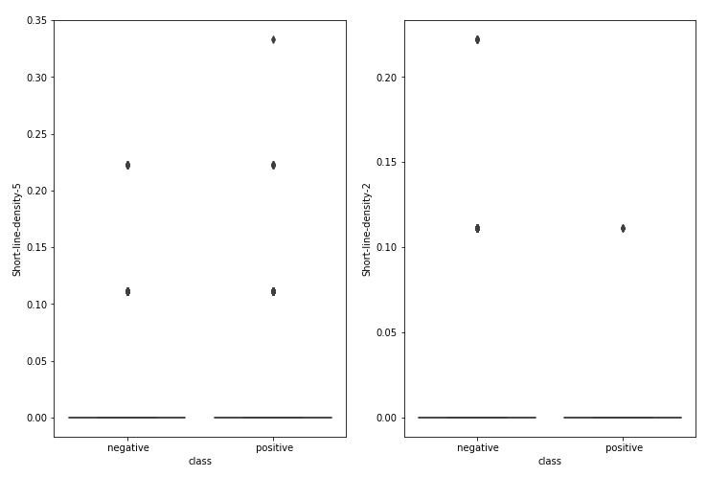
Image Segmentation
short-line-density-5
short-line-density-2
Image Segmentation
short-line-density-2
0
0
0
0
…
0
short-line-density-5
0
0
0
0
…
0
Imbalanced Ratio
1 : 6
Spambase
Data Cleaning
Normalisasi
PCA
Dataset Rebalancing
5-Fold CV
Resample
3-Fold CV
Testing
Hasil
Attributes
20
Observations
2308
Credit Card Fraud

Slide 5
Image Segmentation
Image Segmentation
region-centroid-row
0
1
2
3
…
255
region-centroid-col
0
1
2
3
…
255
Imbalanced Ratio
1 : 6
Spambase
Data Cleaning
Normalisasi
PCA
Dataset Rebalancing
5-Fold CV
Resample
3-Fold CV
Testing
Hasil
Attributes
20
Observations
2308
Credit Card Fraud

Slide 6
Image Segmentation
Image Segmentation
Imbalanced Ratio
1 : 6
Spambase
Data Cleaning
Normalisasi
PCA
Dataset Rebalancing
5-Fold CV
Resample
3-Fold CV
Testing
Hasil
Attributes
15
Observations
2308
Credit Card Fraud

Slide 7
Image Segmentation
Image Segmentation
Spambase
Data Cleaning
Normalisasi
PCA
Dataset Rebalancing
5-Fold CV
Resample
3-Fold CV
Testing
Hasil
Credit Card Fraud

Slide 8
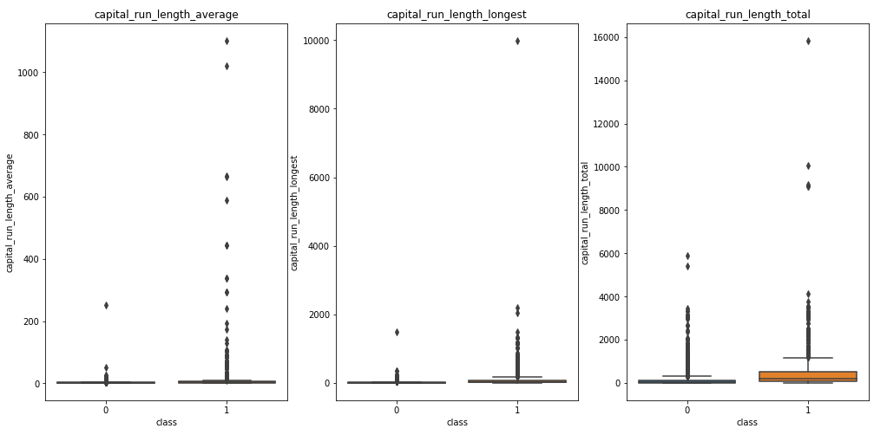
Spambase
Image Segmentation
Image Segmentation
Spambase Dataset
Imbalanced Ratio
2 : 3
Data Cleaning
Normalisasi
PCA
Dataset Rebalancing
5-Fold CV
Resample
3-Fold CV
Testing
Hasil
Attributes
58
Observations
4601
4000
200
1400
Credit Card Fraud

Slide 9
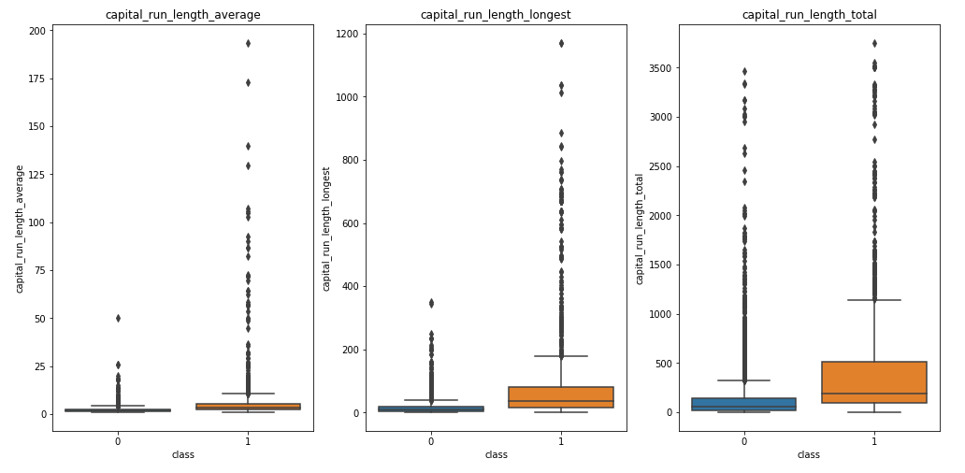
Spambase
Image Segmentation
Image Segmentation
Spambase Dataset
Imbalanced Ratio
2 : 3
Data Cleaning
Normalisasi
PCA
Dataset Rebalancing
5-Fold CV
Resample
3-Fold CV
Testing
Hasil
Attributes
58
Observations
4601
Credit Card Fraud

Slide 10
Spambase
Image Segmentation
Image Segmentation
Spambase Dataset
Imbalanced Ratio
2 : 3
Data Cleaning
Normalisasi
PCA
Dataset Rebalancing
5-Fold CV
Resample
3-Fold CV
Testing
Hasil
Attributes
58
Observations
4580
Credit Card Fraud

Slide 11
Image Segmentation
Image Segmentation
Spambase
Spambase
Data Cleaning
Normalisasi
PCA
Dataset Rebalancing
5-Fold CV
Resample
3-Fold CV
Testing
Hasil
Credit Card Fraud
Credit Card Fraud

Slide 12
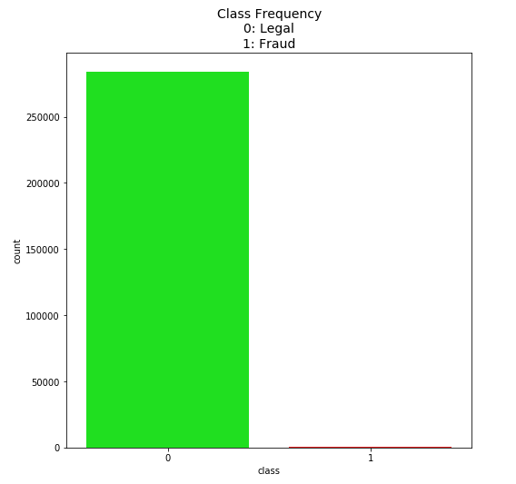
Credit Card Fraud
Image Segmentation
Image Segmentation
Credit Card Fraud Dataset
Imbalanced Ratio
Spambase
Spambase
1 : 577
Data Cleaning
Normalisasi
PCA
Dataset Rebalancing
5-Fold CV
Resample
3-Fold CV
Testing
Hasil
Attributes
30
Observations
284807

Slide 13
Credit Card Fraud
 | Time | V1 | V2 | … | V27 | V28 | Amount
count | 284807.00000 | 2.848070e+05 | 2.848070e+05 | … | 2.848070e+05 | 2.848070e+05 | 284807.00000
mean | 94813.859575 | 1.758743e-12 | -8.252298e-13 | … | 3.332112e-12 | -3.518886e-12 | 88.349619
std | 47488.145955 | 1.958696e+00 | 1.651309e+00 | … | 4.036325e-01 | 3.300833e-01 | 250.120109
min | 0.000000 | -5.640751e+01 | -7.271573e+01 | … | -2.256568e+01 | -1.543008e+01 | 0.000000
25% | 54201.500000 | -9.203734e-01 | -5.985499e-01 | … | -7.083953e-02 | -5.295979e-02 | 5.600000
50% | 84692.000000 | 1.810880e-02 | 6.548556e-02 | … | 1.342146e-03 | 1.124383e-02 | 22.000000
75% | 139320.50000 | 1.315642e+00 | 8.037239e-01 | … | 9.104512e-02 | 7.827995e-02 | 77.165000
max | 172792.00000 | 2.454930e+00 | 2.205773e+01 | … | 3.161220e+01 | 3.384781e+01 | 25691.160000
Image Segmentation
Time
284807.00000
94813.859575
47488.145955
0.000000
54201.500000
84692.000000
139320.50000
172792.00000
Image Segmentation
Amount
284807.00000
88.349619
250.120109
0.000000
5.600000
22.000000
77.165000
25691.160000
Credit Card Fraud Dataset
Imbalanced Ratio
Spambase
Spambase
1 : 577
Data Cleaning
Normalisasi
PCA
Dataset Rebalancing
5-Fold CV
Resample
3-Fold CV
Testing
Hasil
Attributes
30
Observations
284807
Sebaran data di sekitar 0

Slide 14
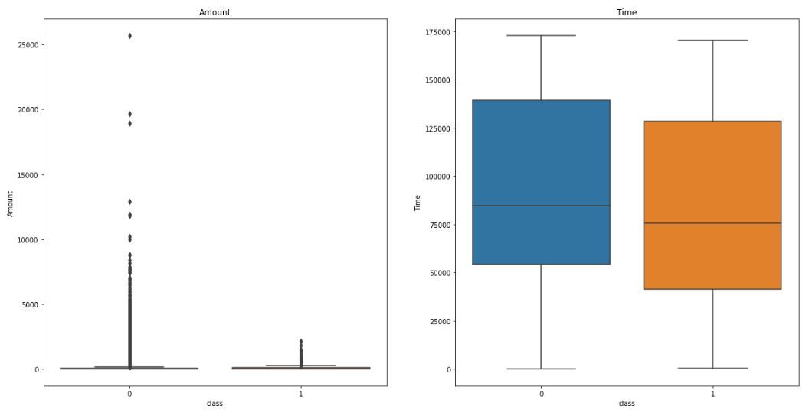
Credit Card Fraud
Image Segmentation
Image Segmentation
Time
284807.00000
94813.859575
47488.145955
0.000000
54201.500000
84692.000000
139320.50000
172792.00000
Amount
284807.00000
88.349619
250.120109
0.000000
5.600000
22.000000
77.165000
25691.160000
Credit Card Fraud Dataset
Imbalanced Ratio
Spambase
Spambase
1 : 577
Data Cleaning
Normalisasi
PCA
Dataset Rebalancing
5-Fold CV
Resample
3-Fold CV
Testing
Hasil
Attributes
30
Observations
284807
4000

Slide 15
df = removeOutlier(df, 'Amount', 5000)
df = removeOutlier(df, 'V3', 5)
df = removeOutlier(df, 'V3', -30, False)
df = removeOutlier(df, 'V5', -40, False)
df = removeOutlier(df, 'V6', 30)
df = removeOutlier(df, 'V7', 50)
df = removeOutlier(df, 'V8', -45, False)
df = removeOutlier(df, 'V9', 10)
df = removeOutlier(df, 'V10', 20)
df = removeOutlier(df, 'V12', 5)
df = removeOutlier(df, 'V13', 5)
df = removeOutlier(df, 'V13', -5, False)
df = removeOutlier(df, 'V15', 7)
df = removeOutlier(df, 'V15', -4, False)
df = removeOutlier(df, 'V16', 10)
df = removeOutlier(df, 'V19', -5, False)
df = removeOutlier(df, 'V20', -40, False)
df = removeOutlier(df, 'V20', 30)
df = removeOutlier(df, 'V21', 25)
df = removeOutlier(df, 'V21', -30, False)
df = removeOutlier(df, 'V22', -7.5, False)
df = removeOutlier(df, 'V22', 7.5)
df = removeOutlier(df, 'V25', -8, False)
df = removeOutlier(df, 'V27', 15)
df = removeOutlier(df, 'V27', -15, False)
df = removeOutlier(df, 'V28', 15)
df = removeOutlier(df, 'V28', -11, False)
Credit Card Fraud
Image Segmentation
Image Segmentation
Credit Card Fraud Dataset
Imbalanced Ratio
Spambase
Spambase
1 : 577
Data Cleaning
Normalisasi
PCA
Dataset Rebalancing
5-Fold CV
Resample
3-Fold CV
Testing
Hasil
Attributes
30
Observations
284807

Slide 16
Credit Card Fraud
Image Segmentation
Image Segmentation
Credit Card Fraud Dataset
Imbalanced Ratio
Spambase
Spambase
1 : 577
Data Cleaning
Normalisasi
PCA
Dataset Rebalancing
5-Fold CV
Resample
3-Fold CV
Testing
Hasil
Attributes
30
Observations
284689
-118
Credit Card Fraud

Slide 17
Image Segmentation
Image Segmentation
Spambase
Spambase
Data Cleaning
Normalisasi
PCA
Dataset Rebalancing
5-Fold CV
Resample
3-Fold CV
Testing
Hasil
Credit Card Fraud
Credit Card Fraud

Slide 18
Image Segmentation
Image Segmentation
Image Segmentation
Spambase
Spambase
Spambase
Data Cleaning
Normalisasi
PCA
Dataset Rebalancing
5-Fold CV
Resample
3-Fold CV
Testing
Hasil
Log Transform (Left Skewed)
MinMax
Credit Card Fraud
Credit Card Fraud
Credit Card Fraud
Standard Transform
Shapiro-Wilk Test

Slide 19
Image Segmentation
Image Segmentation
Image Segmentation
Spambase
Spambase
Spambase
Data Cleaning
Normalisasi
PCA
Dataset Rebalancing
5-Fold CV
Resample
3-Fold CV
Testing
Hasil
Credit Card Fraud
Credit Card Fraud
Credit Card Fraud

Slide 20
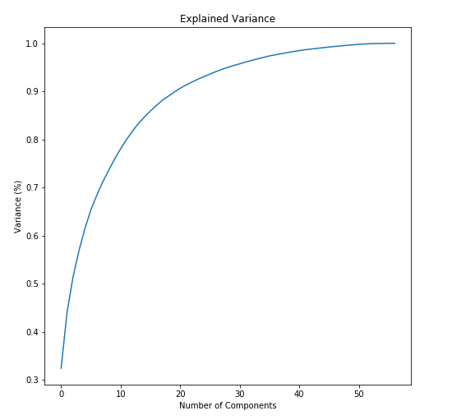
PCA
Spambase
Image Segmentation
Image Segmentation
19 komponen
Spambase
Spambase
Spambase
Data Cleaning
Normalisasi
Dataset Rebalancing
5-Fold CV
Resample
3-Fold CV
Testing
Hasil
Credit Card Fraud
Credit Card Fraud
Credit Card Fraud

Slide 21
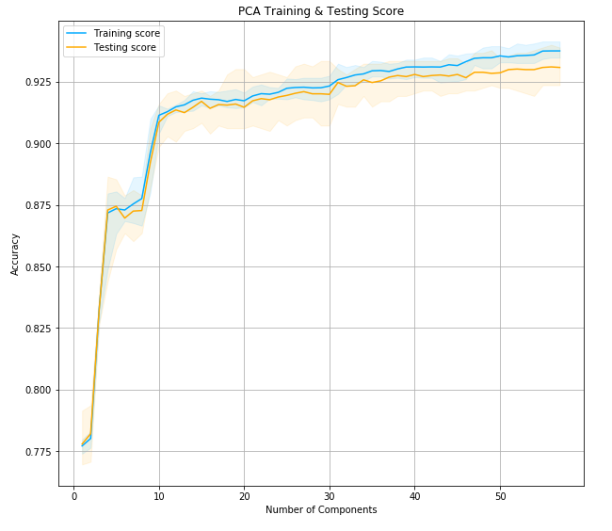
PCA
Spambase
Image Segmentation
Image Segmentation
10 komponen
Spambase
Spambase
Spambase
Data Cleaning
Normalisasi
Dataset Rebalancing
5-Fold CV
Resample
3-Fold CV
Testing
Hasil
Credit Card Fraud
Credit Card Fraud
Credit Card Fraud

Slide 22
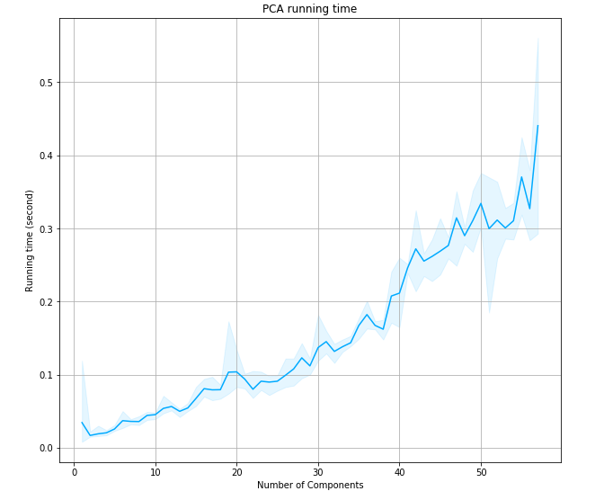
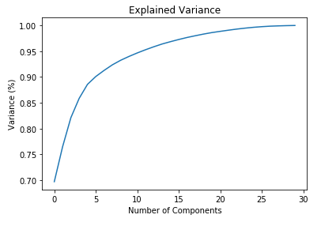
PCA
Spambase
Credit Card Fraud
Image Segmentation
Image Segmentation
Spambase
Spambase
Spambase
Data Cleaning
Normalisasi
Dataset Rebalancing
5-Fold CV
Resample
3-Fold CV
Testing
Hasil
4 komponen
Credit Card Fraud
Credit Card Fraud
Credit Card Fraud
10 komponen

Slide 23
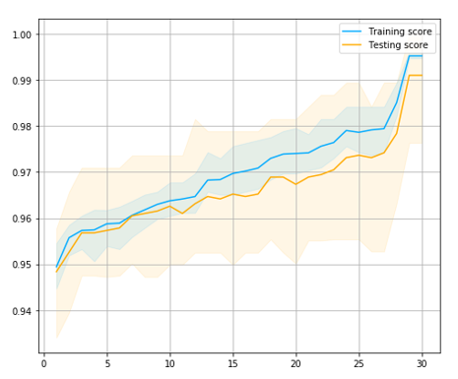
PCA
Spambase
Credit Card Fraud
Image Segmentation
Image Segmentation
Spambase
Spambase
Spambase
Data Cleaning
Normalisasi
Dataset Rebalancing
5-Fold CV
Resample
3-Fold CV
Testing
Hasil
Credit Card Fraud
2 komponen
Credit Card Fraud
Credit Card Fraud

Slide 24
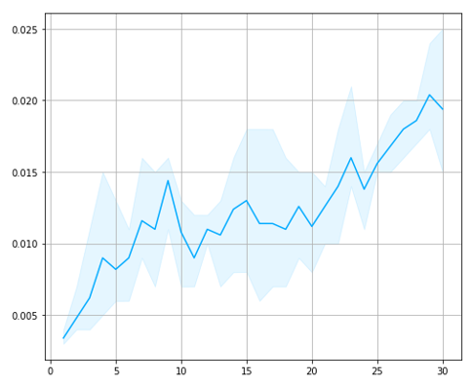
PCA
Spambase
Credit Card Fraud
Image Segmentation
Image Segmentation
Spambase
Spambase
Spambase
Data Cleaning
Normalisasi
Dataset Rebalancing
5-Fold CV
Resample
3-Fold CV
Testing
Hasil
Credit Card Fraud
Credit Card Fraud
Credit Card Fraud
2 komponen

Slide 25
PCA
Credit Card Fraud
Image Segmentation
Image Segmentation
Spambase
Spambase
Spambase
Data Cleaning
Normalisasi
Dataset Rebalancing
5-Fold CV
Resample
3-Fold CV
Testing
Hasil
Credit Card Fraud
Credit Card Fraud
Credit Card Fraud

Slide 26
Image Segmentation
Image Segmentation
Image Segmentation
Spambase
Spambase
Spambase
Spambase
Data Cleaning
Normalisasi
PCA
Dataset Rebalancing
5-Fold CV
Resample
3-Fold CV
Testing
Hasil
Credit Card Fraud
Credit Card Fraud
Credit Card Fraud
Credit Card Fraud
Credit Card Fraud

Slide 27
Image Segmentation
Image Segmentation
Image Segmentation
Image Segmentation
Spambase
Spambase
Spambase
Spambase
Spambase
Data Cleaning
Normalisasi
PCA
Dataset Rebalancing
5-Fold CV
Resample
3-Fold CV
Testing
Hasil
Credit Card Fraud
Credit Card Fraud
Credit Card Fraud
Credit Card Fraud
Credit Card Fraud
Credit Card Fraud

Slide 28
Image Segmentation
Image Segmentation
Image Segmentation
Image Segmentation
Balanced Image Segmentation
Spambase
Spambase
Spambase
Spambase
Spambase
Balanced Spambase
Data Cleaning
Normalisasi
PCA
Dataset Rebalancing
5-Fold CV
Resample
3-Fold CV
Testing
Hasil
Credit Card Fraud
Credit Card Fraud
Credit Card Fraud
Credit Card Fraud
Credit Card Fraud
Credit Card Fraud
Balanced Credit Card Fraud

Slide 29
Image Segmentation
Image Segmentation
Image Segmentation
Image Segmentation
Balanced Image Segmentation
Spambase
Spambase
Spambase
Spambase
Spambase
Balanced Spambase
Model Machine Learning
Data Cleaning
Normalisasi
PCA
Dataset Rebalancing
5-Fold CV
Resample
3-Fold CV
Testing
Hasil Akhir
Credit Card Fraud
Credit Card Fraud
Credit Card Fraud
Credit Card Fraud
Credit Card Fraud
Credit Card Fraud
Balanced Credit Card Fraud

Slide 30
Image Segmentation
Image Segmentation
Image Segmentation
Image Segmentation
Balanced Image Segmentation
Spambase
Spambase
Spambase
Spambase
Spambase
Balanced Spambase
Model Machine Learning
Hasil
Data Cleaning
Normalisasi
PCA
Dataset Rebalancing
5-Fold CV
Resample
3-Fold CV
Testing
Hasil Akhir
Credit Card Fraud
Credit Card Fraud
Credit Card Fraud
Credit Card Fraud
Credit Card Fraud
Credit Card Fraud
Balanced Credit Card Fraud

Slide 31
Image Segmentation
Image Segmentation
Image Segmentation
Image Segmentation
Balanced Image Segmentation
Spambase
Spambase
Spambase
Spambase
Spambase
Balanced Spambase
Model Machine Learning
Hasil
Data Cleaning
Normalisasi
PCA
Dataset Rebalancing
5-Fold CV
Resample
3-Fold CV
Testing
Hasil Akhir
Credit Card Fraud
Credit Card Fraud
Credit Card Fraud
Credit Card Fraud
Credit Card Fraud
Credit Card Fraud
Balanced Credit Card Fraud

Slide 32
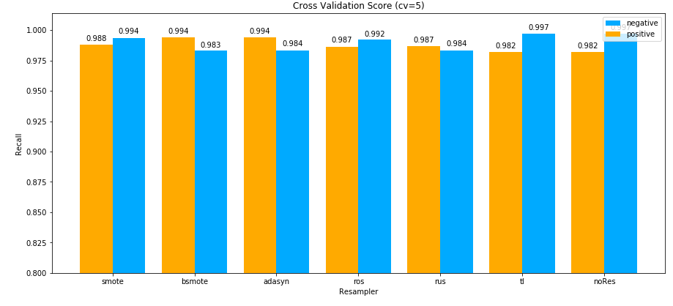
OVERVIEW
Segmentation Dataset
Imbalanced Ratio
1 : 6
Attributes
17
Observations
2308
Spambase Dataset
Credit Card Fraud Dataset
Imbalanced Ratio
2 : 3
Imbalanced Ratio
1 : 57
Attributes
58
Attributes
30
Observations
4601
Observations
284807

Slide 33
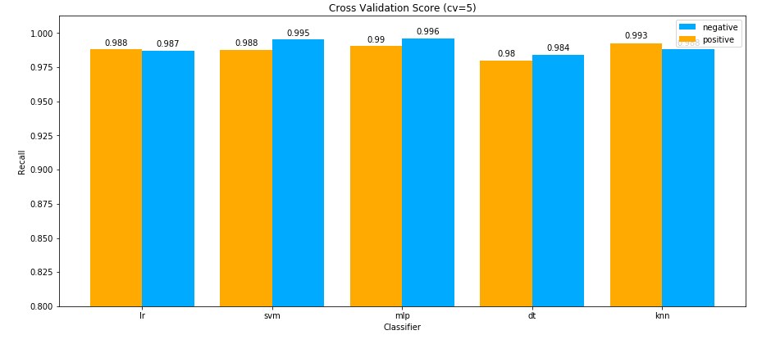
OVERVIEW
Segmentation Dataset
Imbalanced Ratio
1 : 6
Attributes
17
Observations
2308
Spambase Dataset
Credit Card Fraud Dataset
Imbalanced Ratio
2 : 3
Imbalanced Ratio
1 : 57
Attributes
58
Attributes
30
Observations
4601
Observations
284807

Slide 34
Documents and Code:
http://github.com/zkgz/skripsi

Slide 35


Uniform KNN
$$x_{2}$$
k = 3
= 0
= 3
=
pred
$$x_{1}$$

Slide 36
Weighted KNN 1
$$x_{2}$$
k = 5
=
=
$$x_{1}$$

Slide 37
Weighted KNN 1
$$x_{2}$$
k = 5
=
2
=
3
$$x_{1}$$

Slide 38
Weighted KNN 1
$$x_{2}$$
k = 5
=
=
=
pred
$$x_{1}$$

Slide 39


Weighted KNN 2
$$x_{2}$$
k = 3
=
$$\frac{1}{6}$$
=
$$\frac{2}{14}$$
=
pred
$$x_{1}$$

